Slide 1
Hello, we are the French team !
We are Sardonna, Hao, Joshua, Stefan, and Benoît.
We come from the hospitality school of Paris !
Let us remind you about our company:
we want to create an application to help us find a job.

Slide 2
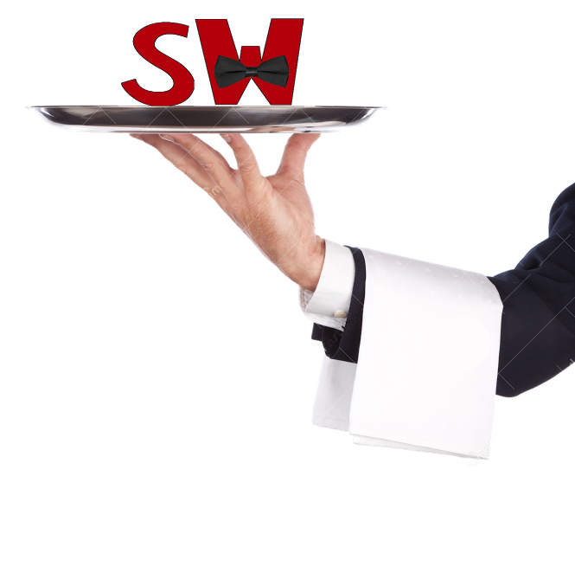
SUPER WAITER
Best staff on a plate
Super waiter is an application about linking employees and employers in the hospitality and catering sectors

Slide 3
Concept of the application
This application is available on app store and play store
It is there to answer the needs of the graduates who want to work for a luxury restaurant
And for luxury restaurant owners or managers, it is the easiest way to get qualified staff
We ensure our customers with a reliable and immediate answer

Slide 4
How we are going to sell our mobile app

Slide 5
Join the community

Slide 6
Join the community
We know that a stranger is often viewed with a skeptical eye, but a member of the community is one step closer to being a friend.
So we shouldn’t just hide behind our website and reach out only when we need to make a sale.

Slide 7
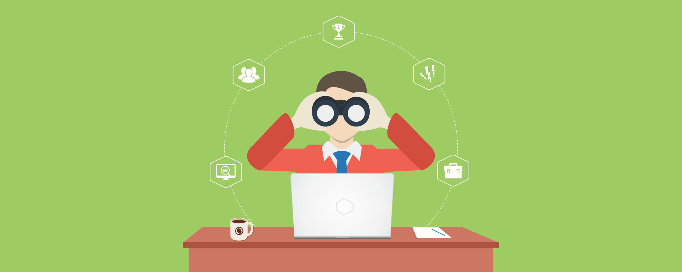
Research our prospects

Slide 8
Research our prospects
Before picking up the phone to call a prospect, it often pays to take a quick look at their website to see what the business is about.
We might even spot a great opportunity that our mobile strategies would be perfect for this business.

Slide 9
Never drive the conversation

Slide 10
Never drive the conversation
The most important thing we can do is listen to customers’ needs. Then we’ll know exactly how our mobile app can help them accomplish something that we know is important to them.
If we’re too busy selling and driving the conversation toward a closing without hearing these valuable information, we’ll miss out.

Slide 11
Work to make it work

Slide 12
Work to make it work
We should never try to mold the customer to our reseller business. When selling our app, we should always mold our business to the customer.
Whatever we have, the goal will be to find the ways that it can deliver value to our prospect.
This can take some effort but we need to invest the energy to adapt the mobile world to suit the customer, not the other way around.

Slide 13
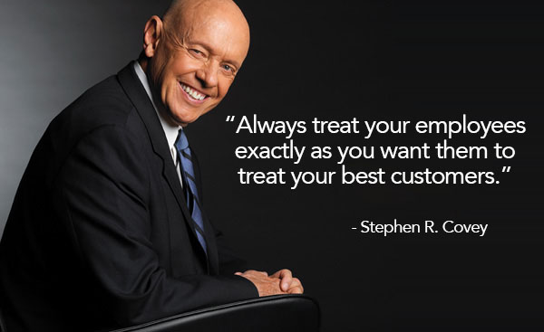
Always remember ...

Slide 14
Treat the customer like a person
We should never treat our prospects like a sale. Instead we should take a moment and put ourselves in theirs shoes.
What are they concerned about? How might they perceive a mobile app seller calling them up? What would help them fell more comfortable ?

Slide 15
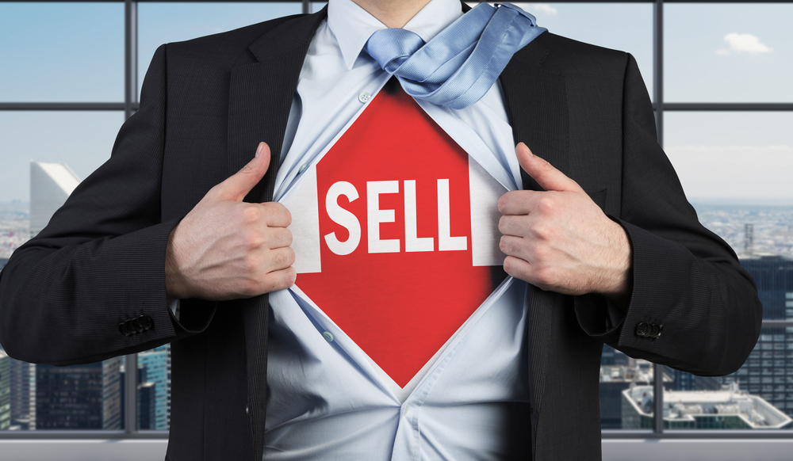
Be proactive when selling apps

Slide 16
Be proactive when selling apps
We know that sales don’t make themselves (unless it’s our lucky day)
We need to keep the dialogue and follow up in order for good things to happen.
We need to keep motivation strong so that we can continue pedalling no matter what each days brings.

Slide 17
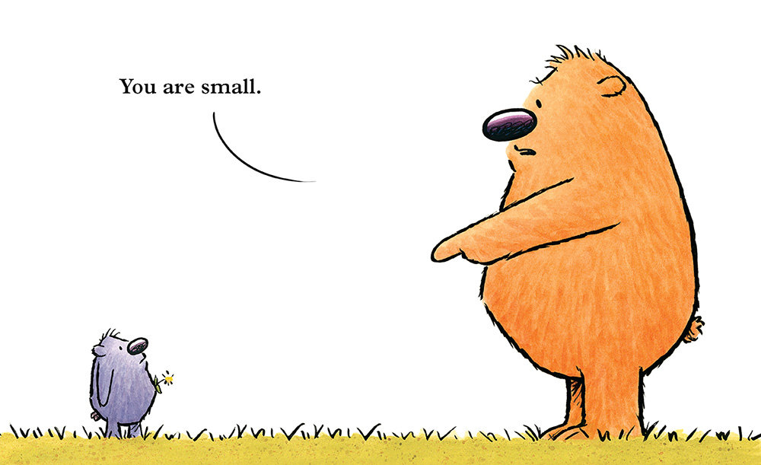
Never make them feel small

Slide 18
Never make them feel small
Small business owners are independent people who take pride in their business and self-identify with it, often to a large degree.
We think it’s a great idea to try and show that we understand their concerns by talking about « small business » over and over again but the word « small » is sometimes a word to be avoided.

Slide 19
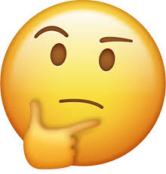
Is this a bad time ?

Slide 20
Is this a bad time ?
If we’re cold calling, sometimes this phrase is a great way to show we know how busy people are.
They’re still going to hang up on us from time to time, but we might just score some points by starting with a polite question
We should always remember that :
we never have a second chance to make a goof first impression !!!

Slide 21
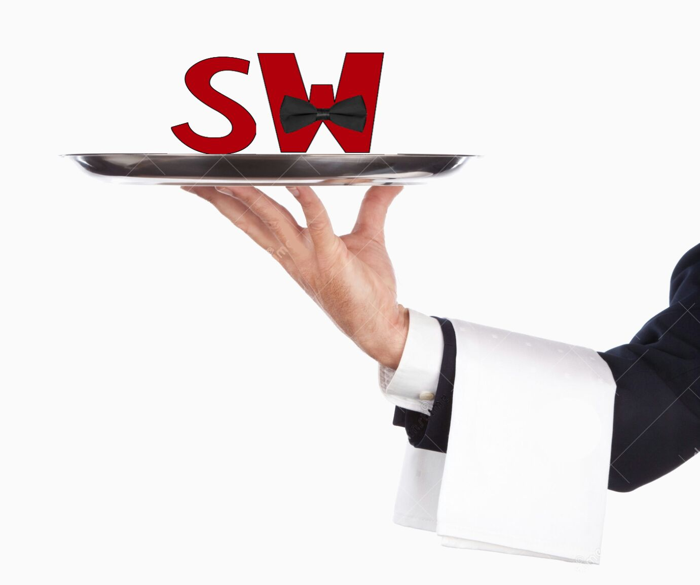
We hope you enjoyed our presentation ;)
Thank you for listening to us !

