Slide 1
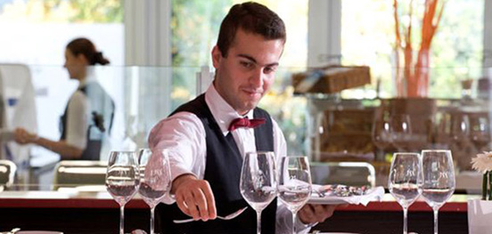
Market research RECRUITMENT TENDeNCiES IN HOSPITALITY AND CATERING SECTORs

Slide 2
Secondary market research : General Tendencies of recruitment in France
The hospitality and catering sector is the main one ( here in red )

Slide 3
The needs and methods to find staff
Type de contrats extras ou CDD

Slide 4
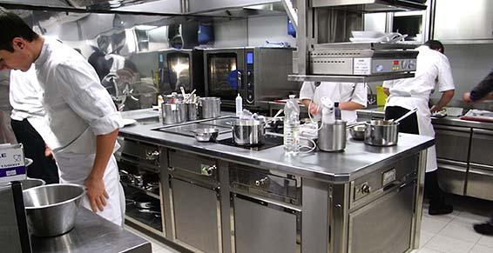
WORKING CONDITIONS
High turn over rate due to dismissals because of bad working conditions :
- working hours : often very early in the morning and then a long break before going back to work at night
- working days : weekends and vacation
- part-time jobs
- numerous fixed-term contracts

Slide 5
Strategies to attract employees
The image of the jobs in the hospitality and catering business
They are seen as:
Enabling guests contact
Stressful
Allowing employees to speak several languages
Allowing junior employees to get more resposiblities et to have great perspectives of evolution in companies.
Consequence: Companies need to recruit new staff frequently

Slide 6
RECRUITMENTS IN HOTEL AND RESTAURANT CHAINS
- These chains represent 40% of hotels and 5% of restaurants in France
- There are more versatile employees in chains than in independent companies
- Recruitment in chains is not so based on qualifications.
- Employees should be flexible.
- The need for staff is high especially in the low-cost catering business: they recruit an average of 10 managers and 100 deputy managers per year.

Slide 7
RECRUITMENT PROCESS
Companies have different tools to deal with applications:
- Evaluation protocole
- Résumés analysis
- interview trainings
- prediction plans
(turn-over and no-show)

Slide 8
PRIMARY MARKET RESEARCH
Our goal: to create a new and efficient recruiting tool
Our survey : we interviewed restaurants and hotels in Paris about their staff needs.
We used the website SURVEY MONKEY to create our questionnaire

Slide 9
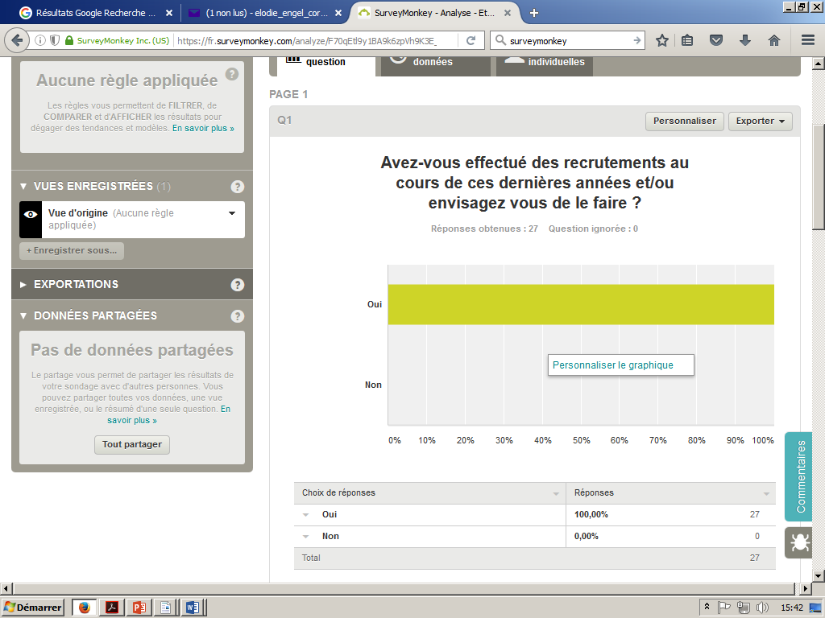
We asked hoteliers and restaurant owners 10 questions:
1: Have you recently hired new staff or do you intend to do so ?
100 percent of hoteliers and caterers intend to hire new staff

Slide 10
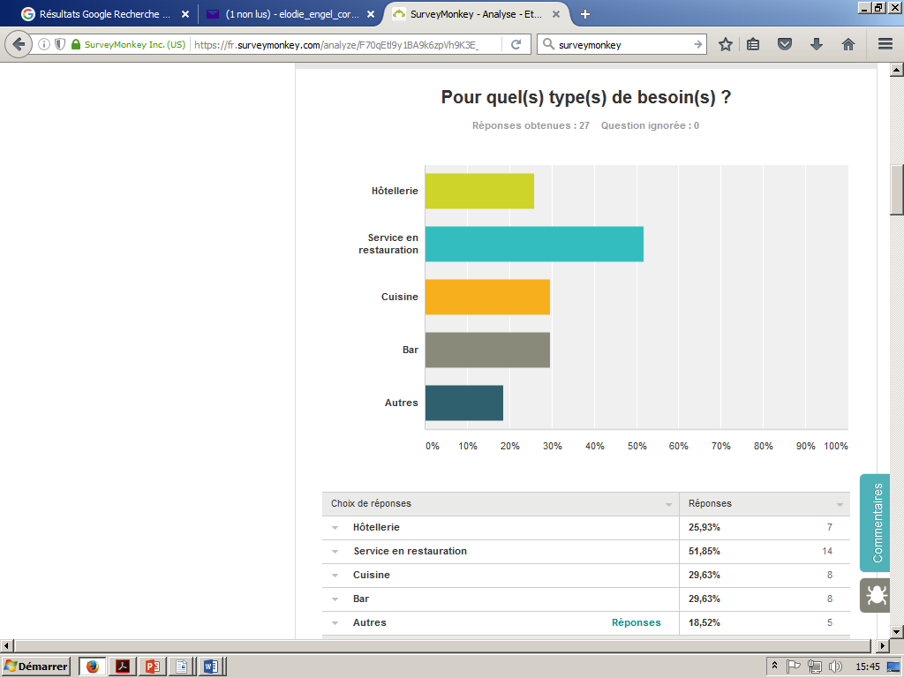
2. In which departments ?
Service, kitchen, and bar

Slide 11
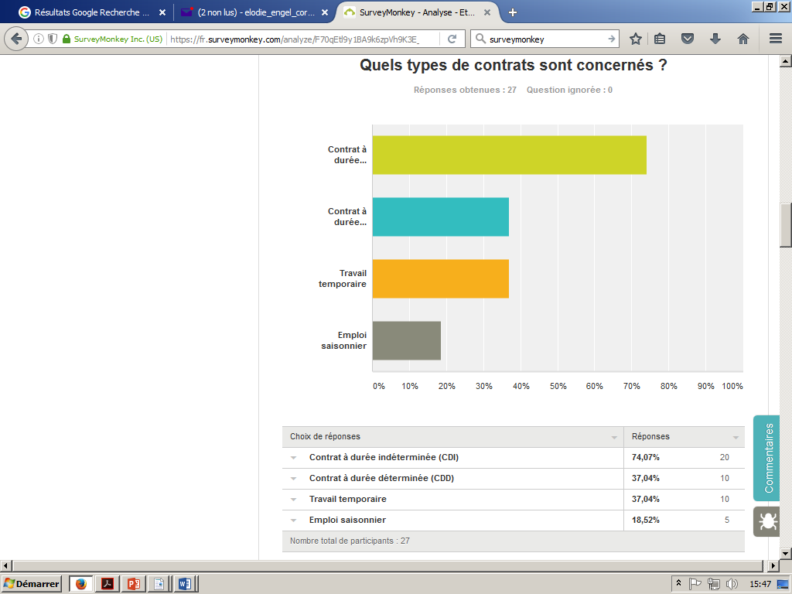
3. What types of contracts are concerned ?
Mostly fixed-term contracts

Slide 12
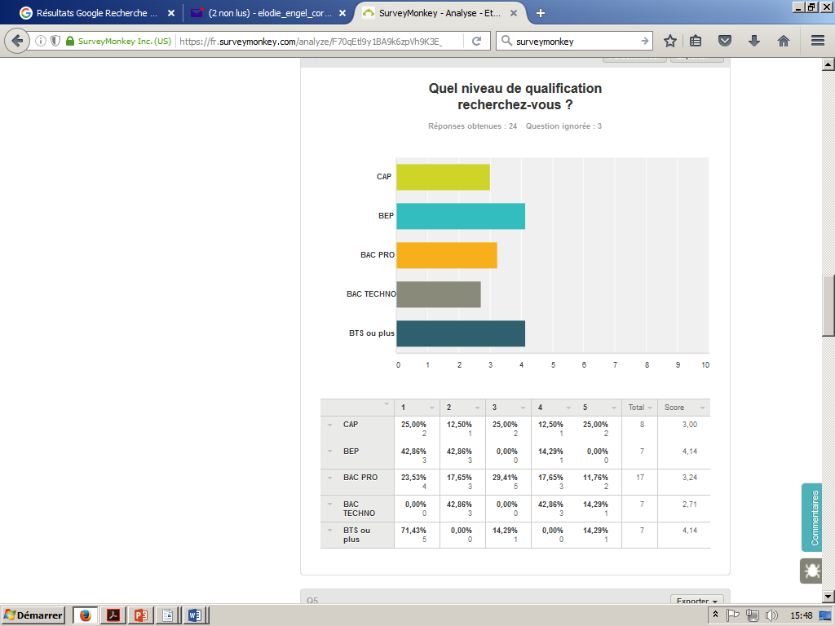
4. What qualifications are you looking for ?
All types of qualifications are sought after

Slide 13
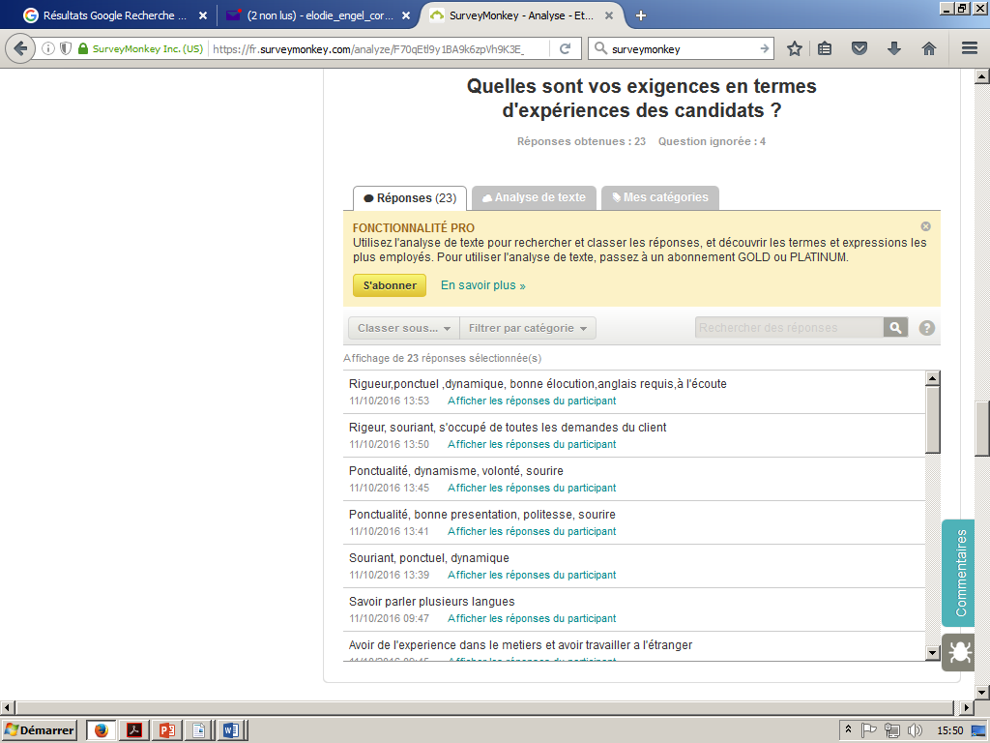
5. What kind of experience are you looking for ?
We need experienced staff in lots of areas such as reception, luxury service, bartending, wine waiting, and international clientele dealing

Slide 14
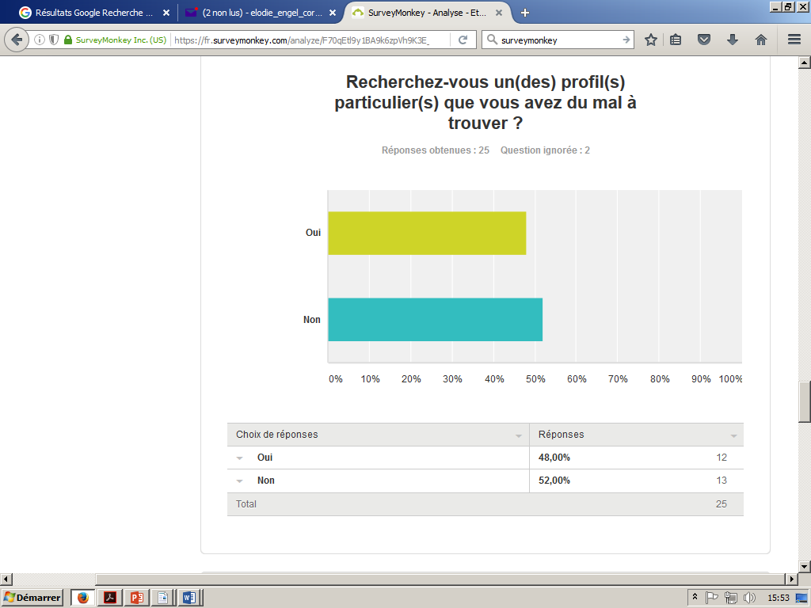
6.Are you looking for any specific skills that are hard to find ?
Half of the employers find it hard to find skilled staff

Slide 15
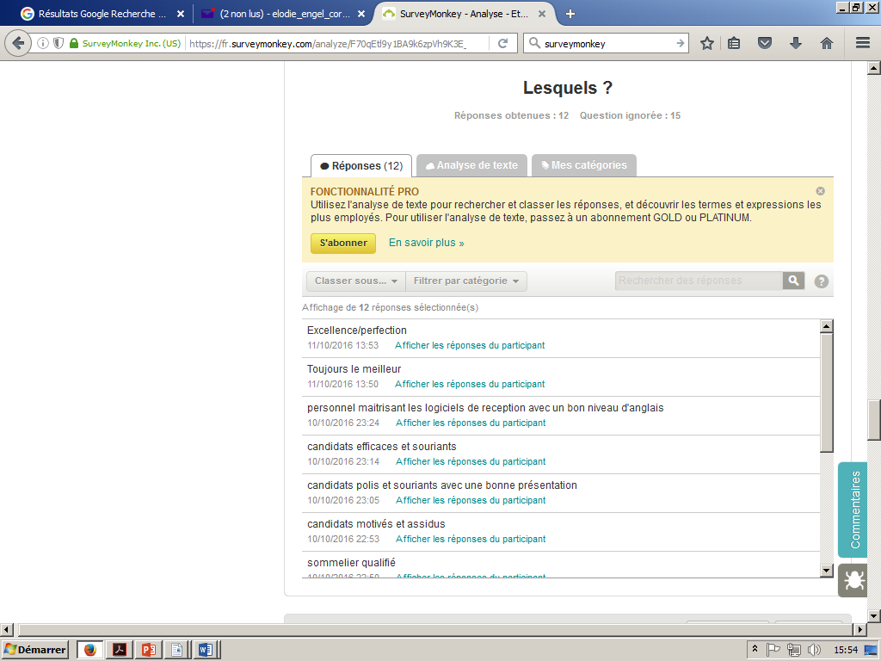
7.Which ones ?
Employers are looking for qualified, smiling, punctual, motivated, efficient staff, with a good English level , and mastering hospitality softwares

Slide 16
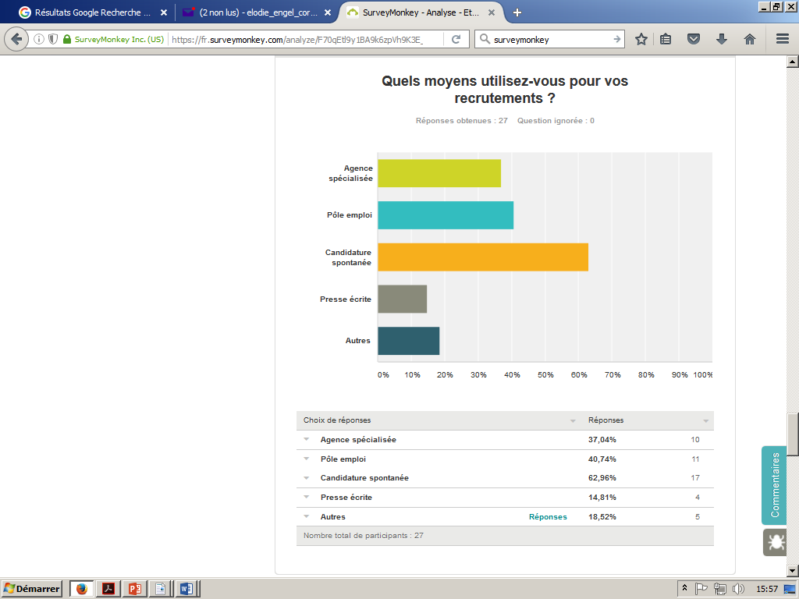
8.How do you usually recruit your staff ?
Speculative applications
National recruitment agencies
Private agencies

Slide 17
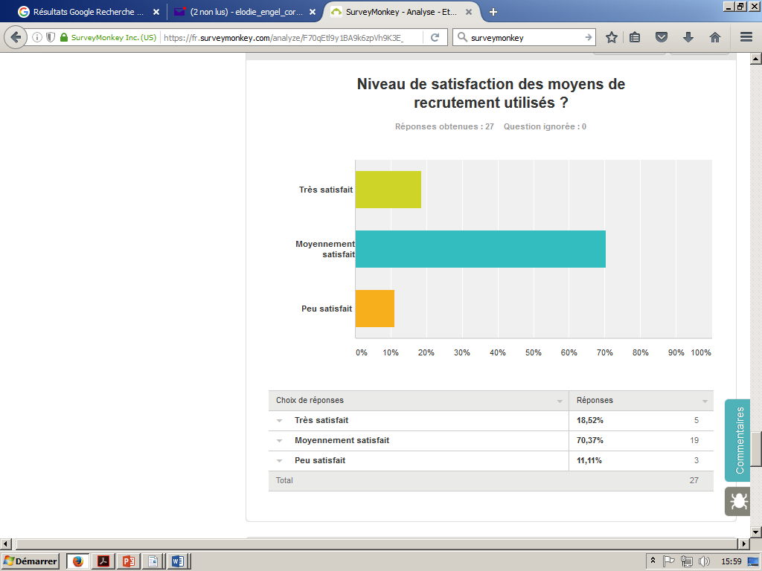
9.How satisfied are you with the recruitment means you are currently using ?
Professionnals are only partially satisfied

Slide 18
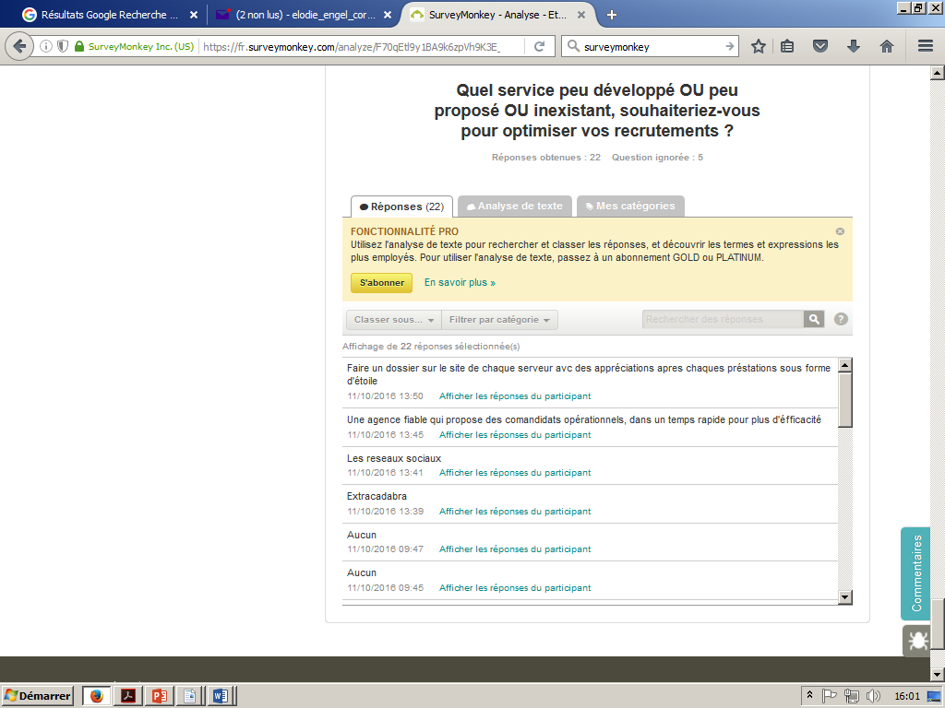
10. What kind of service ( currently unoffered or underdeveloped ) would you like to offer to optimise your staff recruitment ?
Professionals would like to use a system to allow them to evaluate the CV, the skills and the English level of candidates , the testimonies of previous employers, and a fast solution to find qualified staff .

Slide 19
Thanks to our market research, we now know more about the recruitment needs of employers in the hospitality and catering sector in Paris.
We understand that professionals have troubles finding staff.
We are going to create a company to help them recruit skilled staff and to help us find good jobs.
We hope you enjoyed our presentation.
Thank you very much for listening to us !

